Slide 1
Task Placement: When we launch/terminate a task that uses the EC2 launch type, Amazon ECS must determine where to place/terminate the task based on the requirements specified in the task definition, such as CPU and memory. Similarly, in the case of scaling down.
Task placement strategy: is an algorithm for selecting instances for task placement or tasks for termination.

Slide 2
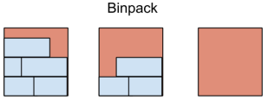
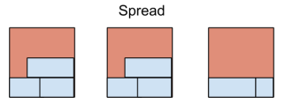
Task Placement Strategies:
Bin pack
Random
Spread

Slide 3
Examples:
"placementStrategy": [ { "field": "memory", "type": "binpack" } ]
"placementStrategy": [ { "type": "random" } ]
"placementStrategy": [ { "field": "instanceId", "type": "spread" } ]

Slide 4
Task Placement Constraints:
A task placement constraint is a rule that is considered during task placement.
distinctInstance: Place each task on a different container instance.
memberOfPlace: tasks on container instances that satisfy an expression.

Slide 5
Task Placement Attributes:
Attributes are nothing but the metadata that we can add to any container instance.
They can be built in or custom.
Built-in attributes are:
ecs.ami-id
ecs.availability-zone
ecs.instance-type
ecs.os-type

